Slide 1
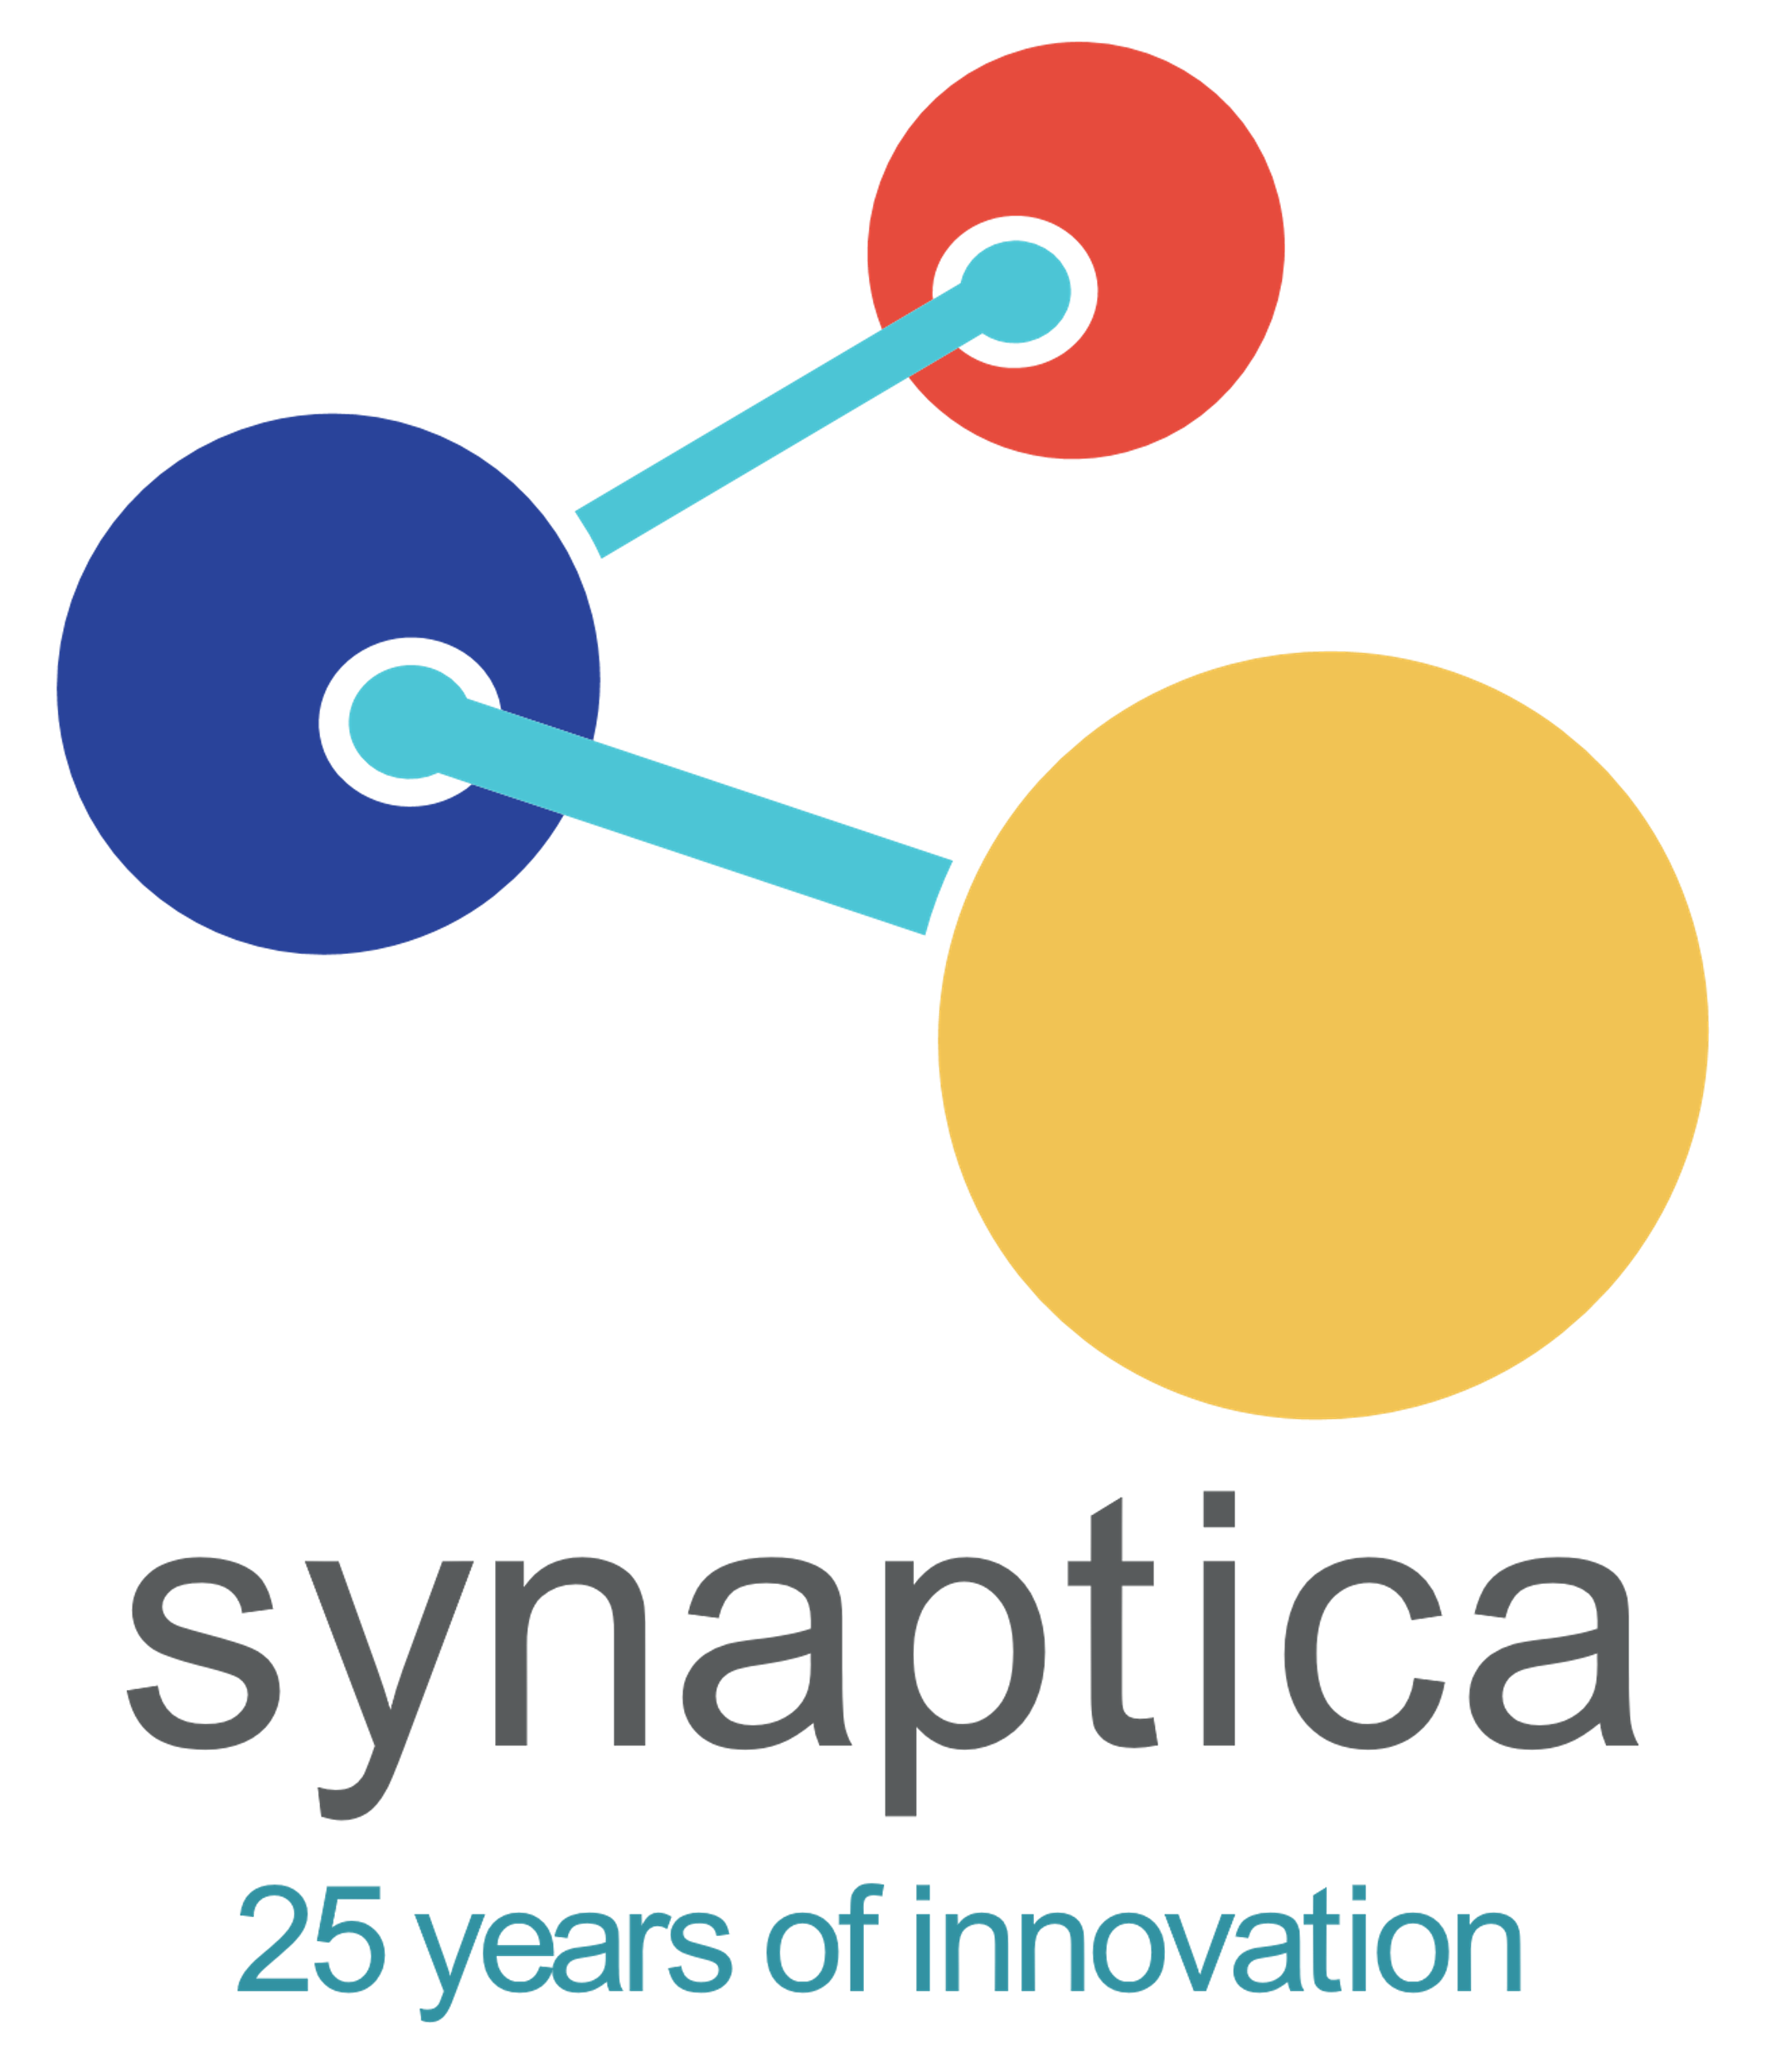


Introduction to Ontology Concepts and Modeling
Tuesday April 20, 2021
Presented by
Bob Kasenchak, Senior Manager, Client Solutions
Ahren E. Lehnert, Senior Manager, Graphite
Bob Kasenchak
Ahren E. Lehnert
© 1995 – 2021, Synaptica®

Slide 2
Workshop Outline
        Introduction & Framing: 55 minutes
        Break: 5 minutes
        IA & Knowledge Graphs: 55 minutes
        Break: 5 minutes
        Knowledge Modeling & Exercise: 60 minutes
 |  | Slide 2 of 8

Slide 3
Workshop Goals?
Complex knowledge organization schemes and concept structures
Basic ontology concepts like RDF and semantic triples
Basics of ontological relationships
Information on existing ontologies for re-use
The difference between upper and lower ontologies
Software systems and components
Ontology modeling exercises

Slide 4


synaptica
The Presenters
25 years of innovation
Bob Kasenchak is a taxonomist and ontologist with a focus on vocabulary development, indexing, software, and text analytics. Developed vocabulary projects for publishers and other enterprise clients.
@taxobob
www.synaptica.com
https://www.linkedin.com/in/bob-kasenchak-332bba55/
bob.kasenchak@synaptica.com
Bob Kasenchak
Senior Manager, Client Solutions
Ahren E. Lehnert is an information and knowledge management professional with nearly twenty years' experience in taxonomy, text analytics, search, and content and records management. Ahren is Senior Manager, Graphite at Synaptica, LLC, a provider of taxonomy, ontology, and text analytics products and services.
@ahrenlehnert
www.synaptica.com
Ahren E. Lehnert
Senior Manager, Graphite
www.linkedin.com/in/ahren-lehnert/
ahren.lehnert@synaptica.com
4

Slide 5
About Synaptica
Over 25 years as an industry leader in KM as a software and services provider.
Adherence to standards and best practices, as well as adopting the latest technologies.
A focus on building tools to support knowledge workers, library and information scientists, taxonomists, and ontologists.
A policy of working with our customers to design and develop software to address their current requirements, as well as to meet future needs.
 |  | Slide 5 of 8

Slide 6

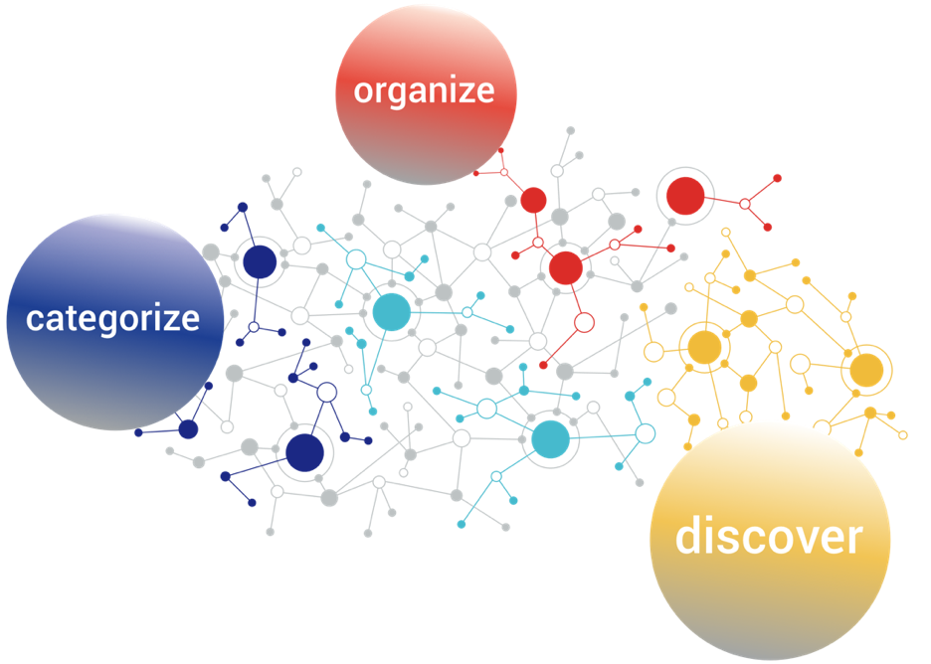
synaptica
Mission
25 years of innovation
Our mission is to help
people organize, categorize and discover enterprise knowledge.
6

Slide 7

synaptica
25 years of innovation
Who are you?
7

Slide 8
synaptica
Basic ontology concepts
25 years of innovation
What is an ontology?
Why do I need an ontology?
Ontology standards: RDF, OWL, SKOS
Classes
Introduction & Framing
8

Slide 9
synaptica
What Is an Ontology?
25 years of innovation
In computer science and information science, an ontology encompasses a representation, formal naming and definition of the categories, properties and relations between the concepts, data and entities that substantiate one, many or all domains of discourse.*
In most use cases, an organization uses ontologies to describe what it knows and what it wants to know and to connect concepts to data/content for knowledge management and information retrieval (knowledge graphs). Other use cases include inference, machine learning, connecting disparate systems, modeling workflows and logistics…and many more.
*“Ontology (information science).” Wikipedia, Wikimedia Foundation, Inc., 3 August 2019, https://en.wikipedia.org/wiki/Ontology_(information_science).
9

Slide 10
synaptica
What Is an Ontology?
25 years of innovation
"In a Semantic Web context, ontologies are a main vehicle for data integration, sharing, and discovery, and a driving idea is that ontologies themselves should be reusable by others."
A Review of the Semantic Web Field
Pascal Hitzler
Communications of the ACM, February 2021
Vol. 64 No. 2, Pages 76-83
DOI 10.1145/3397512
https://cacm.acm.org/magazines/2021/2/250085-a-review-of-the-semantic-web-field/fulltext?s=09
10

Slide 11
synaptica
Taxonomy or Ontology?
25 years of innovation
 | Class Hierarchies | Categorical Hierarchies | Topical Hierarchies
Business Rules | Rigorous set-theoretic class-subclass structures. Every sub-class inherits properties of parent. Leaf-node subclasses may contain a set of named individuals. | Similar to OWL classes and subclasses, SKOS supports a transitive hierarchy of categories and subcategories. SKOS does not distinguish between categories and individuals. | Non-transitive hierarchies. Topical taxonomy structures mixing abstract and concrete categorical concepts and named individuals.
Use Cases | Formal classification schemes intended for machine inferencing, reasoning and object-oriented programming. | Less formal schemes capable of some level of inferencing such as for use with auto categorization. | Granular subject indexing and navigational taxonomies.
Inference Bearing | Yes | Yes | No
Semantic Schema | OWL | SKOS | SKOS
Resource Types | owl:Class owl:NamedIndividual | skos:Concept | skos:Concept
Hierarchical Relationships | rdfs:subClassOf | skos:broaderTransitive skos:narrowerTransitive | skos:broader skos:narrower
Instance-Class Relationship | rdf:type | NA | NA
Many KOS use a mixture of classes and properties from different open data sources, the most common being OWL and SKOS.
If your KOS is primarily based on OWL, then the whole KOS (schema and taxonomy) will be typically be referred to as an Ontology.
If your KOS is primarily based on SKOS the KOS will typically be referred to as a Taxonomy.
11
Notes:
Even a simple SKOS-based KOS is actually an ontology comprising a schema and a taxonomy.
Which may leave you wondering when to call a KOS a taxonomy or an ontology.
The simplest answer lies in how you build hierarchies. If you build strict class-subclass inference-bearing hierarchies with OWL, then your KOS will typically be referred to as an Ontology.
If you build non-transitive hierarchies with SKOS, which is widely adopted for topical and navigational taxonomies, then your KOS will typically be referred to as a Taxonomy.

Slide 12
synaptica
Why Develop Ontologies?
25 years of innovation
Ontologies...
Are a better representation of, and between, domains of knowledge
Bridge heterogenous information sources, especially based on standards
Are supported by standard, portable formats
Are native RDF
Allow for axiomatic reasoning, graph traversal, and inferencing
Include custom relationships and classes
Are the foundational layer for enterprise knowledge graphs
12

Slide 13
synaptica
Relevance to IA
25 years of innovation
Ontologies and IA
Modeling with data
      Using graph/ontological thinking to model relationships between objects in an IA project
      Objects can have custom/unlimited relationships and properties
      Depending on complexity, can be done either "manually" or with software
Using external sources as data points
      Equate objects to external sources to add data and information
Leveraging existing resources
      Information environments can be ingested and included in the model
13

Slide 14
synaptica
Relevance to IA
25 years of innovation
Graph-Driven Environments
Navigate concepts to get to content
Navigate content to get to concepts (for related content)
Resolving entities across graphs to create aggregates
Linking to Linked Data sources to add information
Semantic search
Voice Assistants
      These last two require lots of work and systems integration
14

Slide 15
synaptica
25 years of innovation
Triples
Subject
Object
Predicate
(Verb)
Node
Node
Edge
Entity
Entity
Relationship
15

Slide 16
synaptica
25 years of innovation
Triples: Examples
Bob
New Mexico
Lives in
Dog
Poodle
Has Breed
Is A Breed of
Bob
Ahren
Has Co-worker
16

Slide 17
synaptica
25 years of innovation
Triples: Inference
Bob
Albuquerque
Lives in
Albuquerque
New Mexico
Is In
Bob
New Mexico
Lives in
17

Slide 18
synaptica
25 years of innovation
Place
Ontology as Graph
Is A
Bob
City
Is A
State
Lives in
Is A
Is A
Person
Albuquerque
Is A
New Mexico
Is In
18

Slide 19
synaptica
Ontology Components: Concepts
25 years of innovation
Concepts
A concept is an individual resource such as a Concept or a Named Entity
  Philosophy
  Bob
  Euclid’s “Elements”
Dog food
A concept may represent a class of things or a specific individual thing
Companies
Synaptica
Conferences
IA Conference
IA Conference 2021
19

Slide 20
synaptica
Domains
25 years of innovation
What is a domain? | A domain is an area or several associated areas of knowledge you want to cover in your ontology or ontologies
What domains need to be covered? | Your existing taxonomies and gap analysis should tell you what domains need to be covered
Are there gaps? | Identify publicly available domain ontologies
Is further development required? | Use existing ontologies, Linked Data sources, internal workshops, and end user recommendations to expand the structures
Identify and develop domains (from existing taxonomies)
20

Slide 21
synaptica
Domains
25 years of innovation
Task | Develop an ontology to relate sporting goods, sports, and content describing both
What domains need to be covered? | Sports, Sporting Goods
What resources exist? Are there gaps? | Existing inventory? List of sports?
Sample Domain ID
21

Slide 22
synaptica
Classes
25 years of innovation
What is a class? | Classes group individuals (concepts) that have something in common
Once domains are identified, what makes them mutually exclusive? | People, Places, Organizations, etc.
What properties and attributes are unique to taxonomy concepts? | Group these to define a class; e.g., date of birth, latitude and longitude, stock exchange ticker, etc.
Where do classes overlap? | Some properties, like definition, should exist in all classes and subclasses, while specific properties and relationships only exist in a single class
How are classes and sub-classes defined for inheritance? | Determine which properties and relationships should be defined at the top level for all concepts and which should be defined at the leaf level for the most specific concepts
Identify and plan classes
Class
Sub-Class
Sub-Class
22

Slide 23
synaptica
Classes
25 years of innovation
CLASS Furniture | ATTRIBUTES Price
Chairs | Price, Height
Deck Chairs | Price, Height, Material
Class Hierarchies
Furniture
Chairs
Deck Chairs
23

Slide 24
synaptica
Standards: RDF
25 years of innovation
What is RDF?
RDF is a standard model for data interchange on the Web. RDF has features that facilitate data merging even if the underlying schemas differ, and it specifically supports the evolution of schemas over time without requiring all the data consumers to be changed.*
*“RDF.” W3C Semantic Web, 7 May 2020, https://www.w3.org/RDF/.
24

Slide 25
synaptica
Standards: RDF
25 years of innovation
What is RDF?
RDF stands for Resource Description Framework
RDF is a framework for describing resources on the web
RDF is designed to be read and understood by computers
RDF is not designed for being displayed to people
RDF is written in XML
RDF is a part of the W3C's Semantic Web Activity
RDF is a W3C Recommendation from 10. February 2004*
*“XML RDF.” W3Schools.com, 7 May 2020, https://www.w3schools.com/xml/xml_rdf.asp.
25

Slide 26
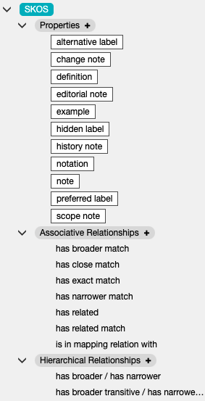
synaptica
Standards: SKOS
25 years of innovation
SKOS Documentation Properties
SKOS Lexical Labels
Use existing, standard properties and relationships used for taxonomies such as what is provided by SKOS
“SKOS…provides a lightweight, intuitive language for developing and sharing new knowledge organization systems.”
https://www.w3.org/TR/skos-reference/
skos:altLabel
skos:changeNote
skos:definition
skos:editorialNote
skos:example
skos:hiddenLabel
skos:historyNote
skos:note
skos:prefLabel
skos:scopeNote
Mapping and Semantic Relations
26

Slide 27
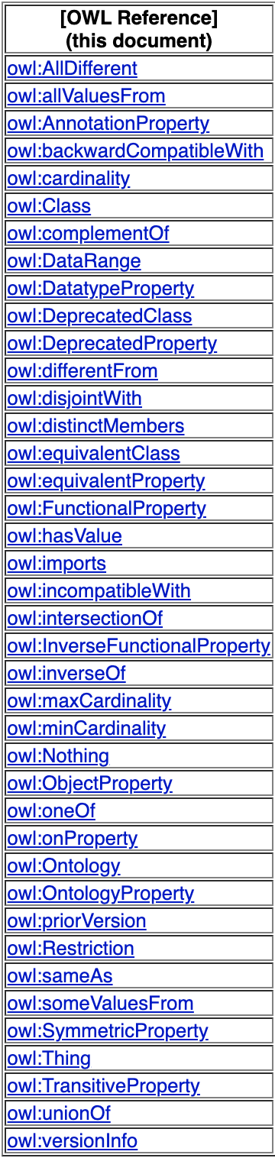
synaptica
Standards: OWL
25 years of innovation
(Also) use existing, standard properties and relationships used for ontologies, such as OWL
“The W3C Web Ontology Language (OWL) is a Semantic Web language designed to represent rich and complex knowledge about things, groups of things, and relations between things.”
https://www.w3.org/OWL
Use OWL Cardinality Constraints & Intersection, Union, and Complement
Use OWL Classes & Relations to Other Properties
27

Slide 28
synaptica
RDF: Namespaces
25 years of innovation
OWL:
Class
Mixing and Matching
DC:
CreateDate
SKOS:
PrefLabel
My ontology
Bob:
hasColor
28

Slide 29


synaptica
Properties & Relationships
25 years of innovation
What are properties and relationships? | Properties are attributes associated with concepts Relationships describe the connection between concepts
What properties do concepts require? | All concepts may require a definition and scope note while only some concepts require properties like latitude and longitude
What relationships between concepts are required? | Beyond the standard broader/ narrower, related, and equivalency (prefLabel and altLabel), the ontology may need uni-directional or inverse relationships to express the connection between concepts, such as hasCountry, hasPart/isPartOf, etc.
What data type makes sense for properties? | Should it be a Boolean (yes/no, true/false), text string, integer, date, or URL?
&
29

Slide 30
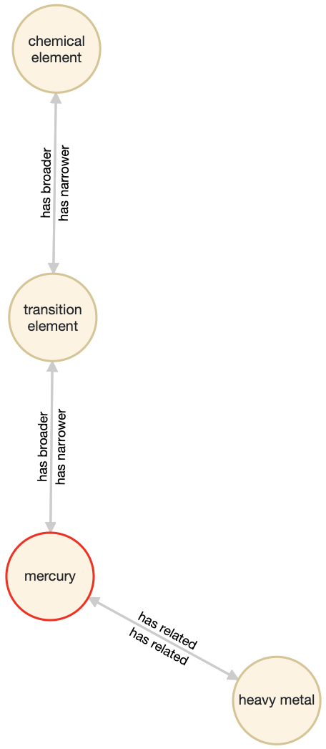
synaptica
Standard Taxonomy Relationships
25 years of innovation
Relationships defined in the ANSI/NISO Z.39.19-2005 (R2010) Guidelines for the Construction, Format, and Management of Monolingual Controlled Vocabularies
Subject
Predicate
Object
Subject
Predicate
Object
30

Slide 31
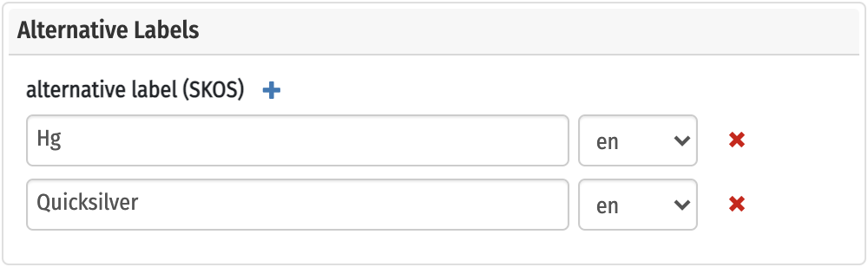

synaptica
Standard Taxonomy Relationships
25 years of innovation
Hierarchical, Equivalence, and Associative Relationships in a visualized model
Hierarchical Relationships
Equivalence Relationships
Associative Relationships
31

Slide 32
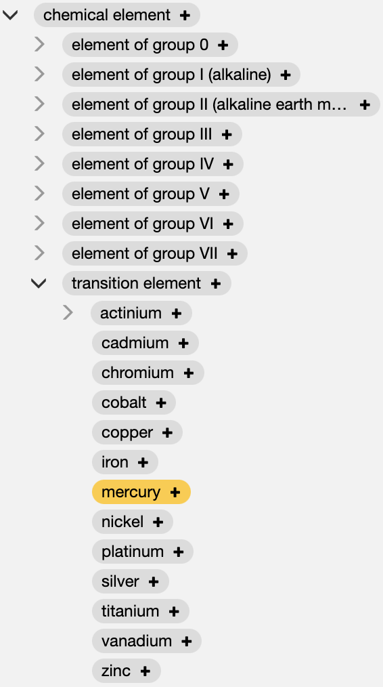
synaptica
Hierarchical Relationships
25 years of innovation
Hierarchical Relationships in a hierarchy
Hierarchical Relationships
32

Slide 33
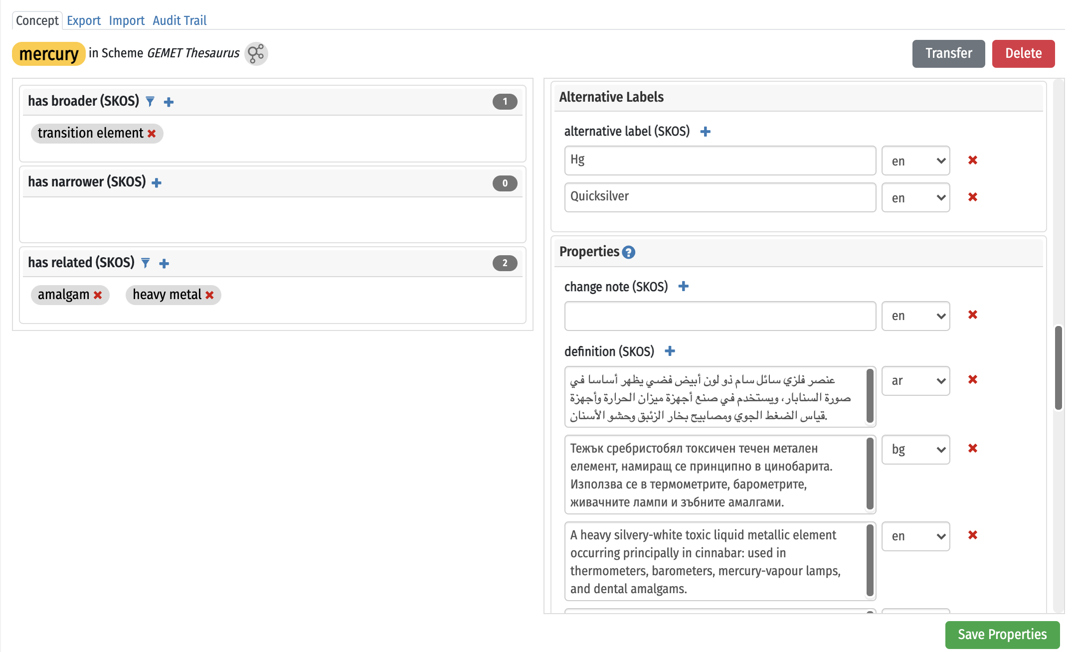
synaptica
Standard Taxonomy Relationships
25 years of innovation
Hierarchical Relationships
Hierarchical, Equivalence, and Associative Relationships in a concept information panel
Equivalence Relationships
Associative Relationships
33

Slide 34
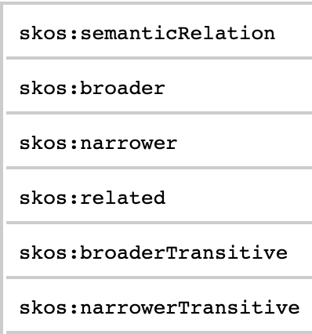
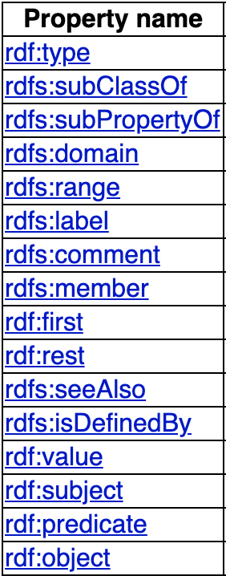
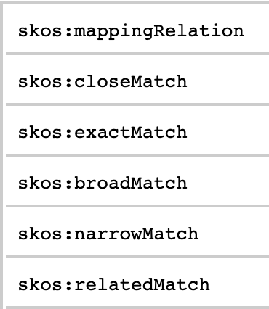
synaptica
Ontology Relationships
25 years of innovation
In addition to standard taxonomy relationships, ontologies will require existing, standard RDF(S), OWL, and SKOS relationships
https://www.w3.org/TR/skos-reference/
https://www.w3.org/OWL
34

Slide 35
synaptica
Ontology Relationships
25 years of innovation
Hierarchical Relationships in a hierarchy
In SKOS,
Broader/Narrower relationships
Hierarchical Relationships
In OWL, all of these are the same (subClass) relationship
35

Slide 36
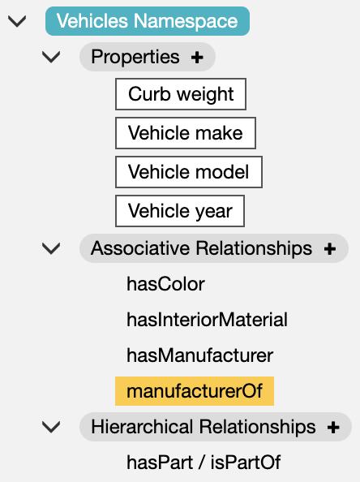
synaptica
Ontology Relationships
25 years of innovation
In addition to standard taxonomy properties and relationships, ontologies will require custom properties and relationships
Properties and Relationships are specific to the Vehicles domain, and are more specific than related to
36

Slide 37
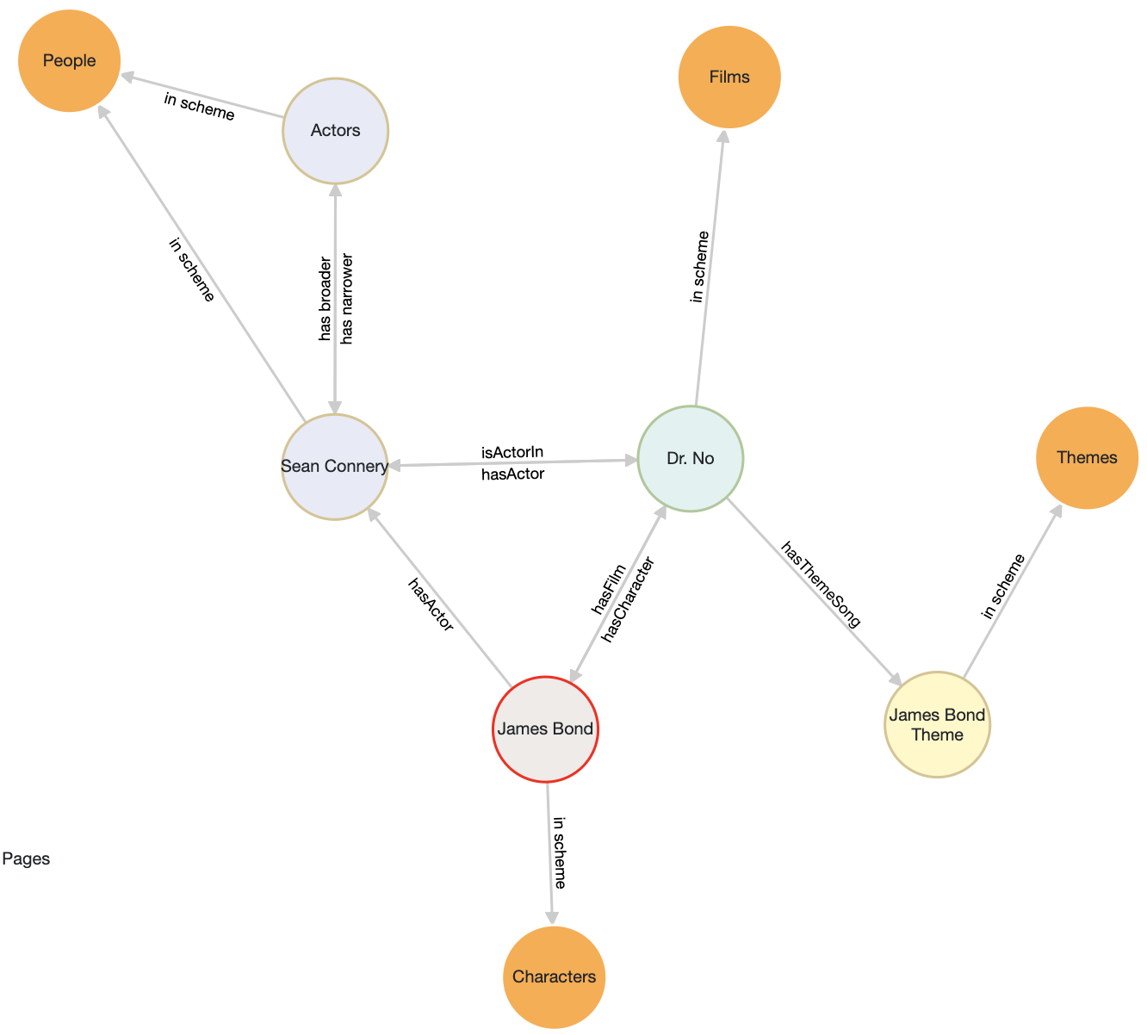
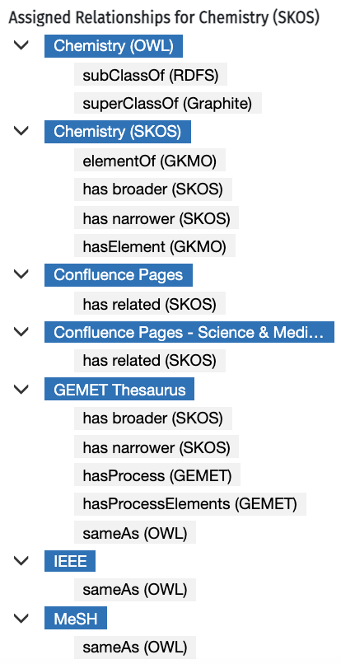
synaptica
Ontology Relationships
25 years of innovation
Hierarchical Relationships
Inter and intra-Scheme SKOS, OWL, and custom relationships
Relationships within and between Schemes
Associative Relationships
37

Slide 38
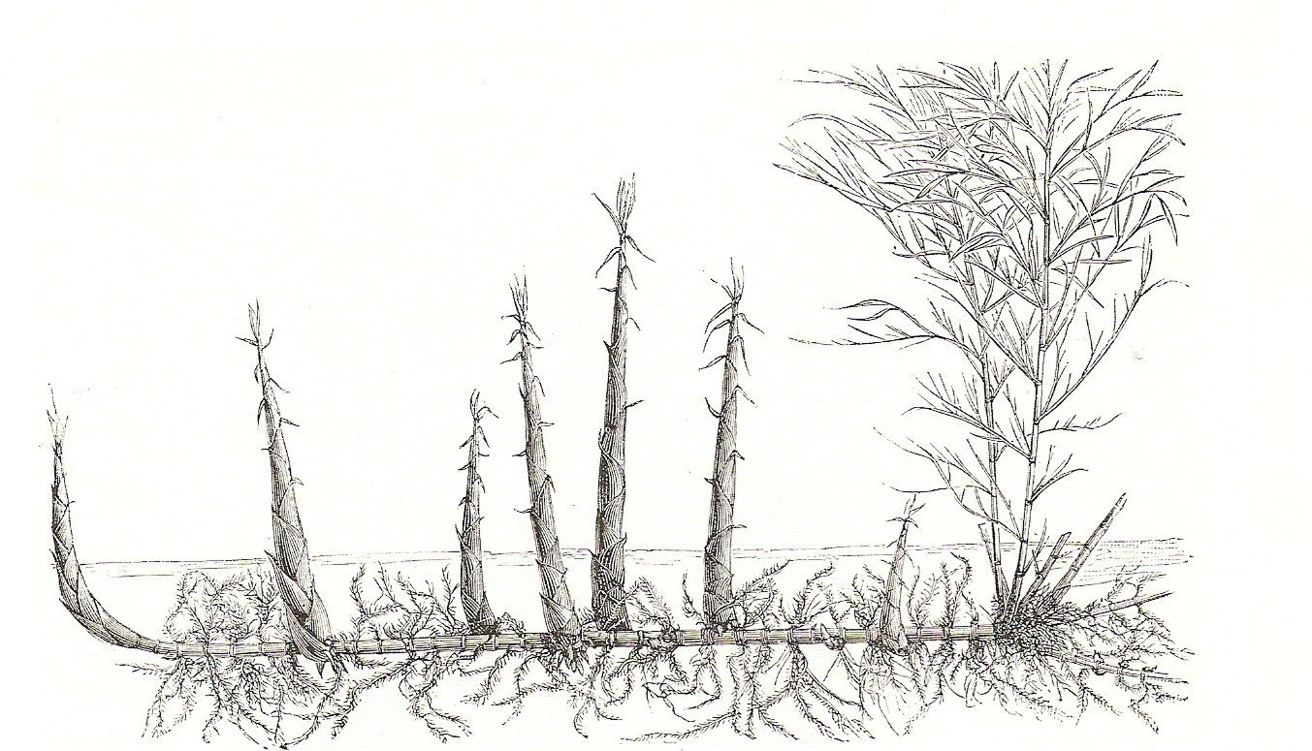
synaptica
Upper & Lower Ontologies
25 years of innovation
What are upper ontologies? | An upper ontology (or foundation ontology) is a model of the commonly shared relations and objects that are generally applicable across a wide range of domain ontologies. It usually employs a core glossary that overarches the terms and associated object descriptions as they are used in various relevant domain ontologies.*
What are lower (domain) ontologies? | A domain ontology (or domain-specific ontology) represents concepts which belong to a realm of the world, such as biology or politics. Each domain ontology typically models domain-specific definitions of terms.*
&
*“Ontology (information science).” Wikipedia, Wikimedia Foundation, Inc., 13 April 2021, https://en.wikipedia.org/wiki/Ontology_(information_science).
38

Slide 39

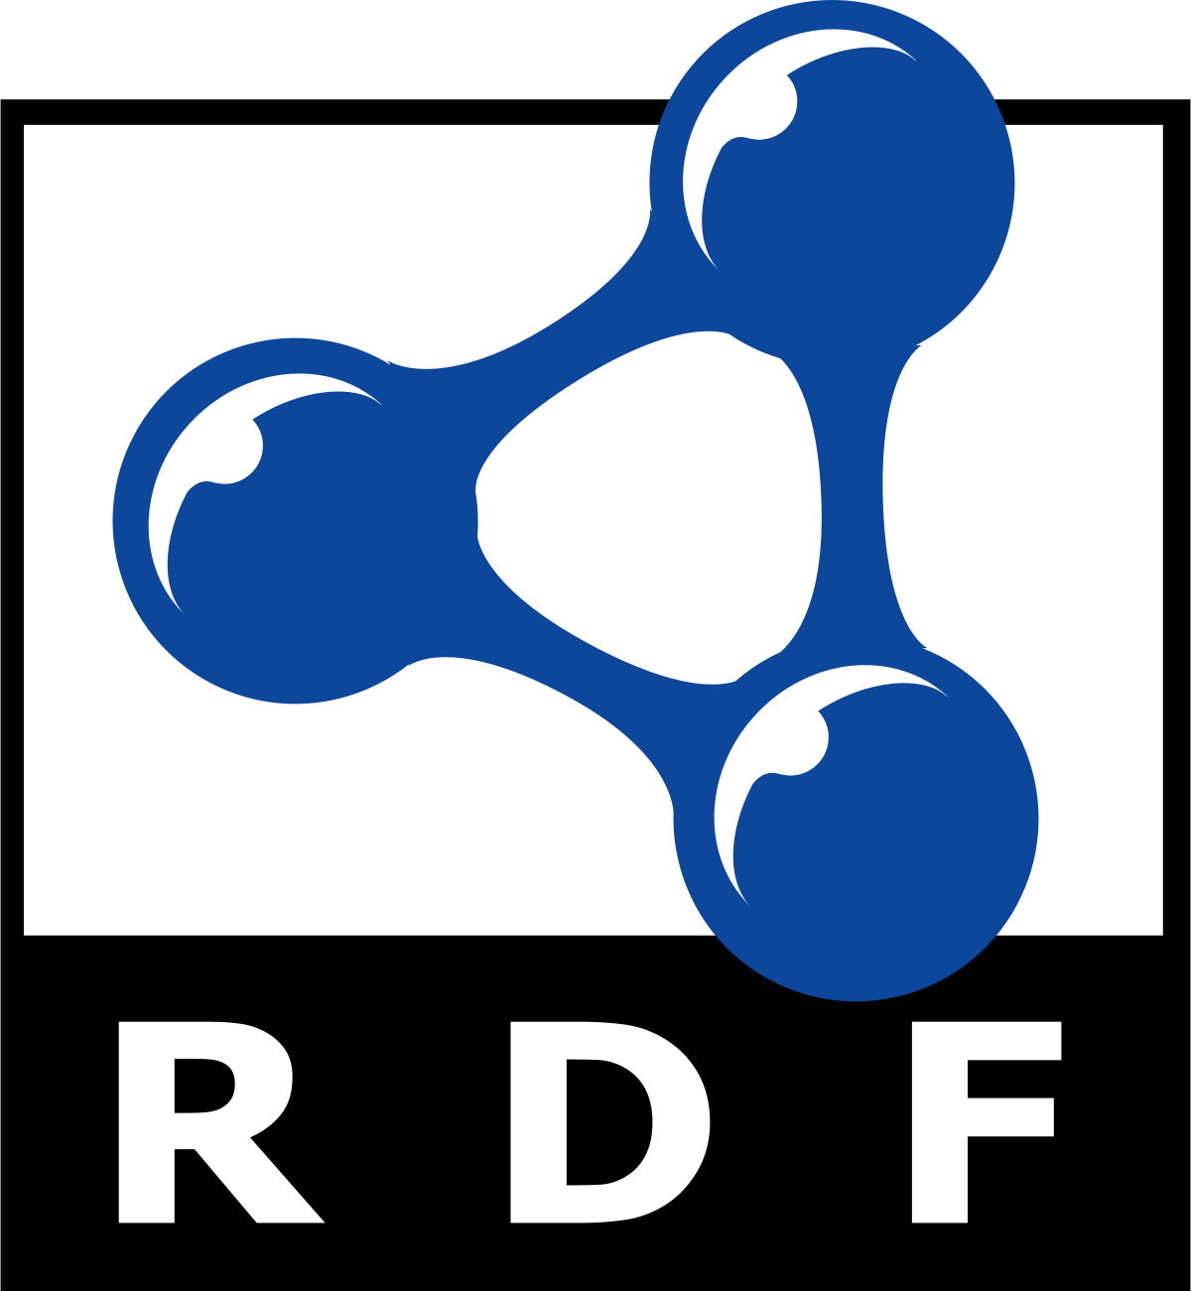
synaptica
Scheme + Taxonomy
25 years of innovation
An Ontology comprises a semantic Schema of class, property and relationship types, plus a Taxonomy of specific concepts, classes and named individuals.
Ontology
Schema
Class Types
Property Types
Relationship Types
Taxonomy
Specific Concepts, Classes & Named Individuals
+
By selecting class, property and relationship types from open data resources like SKOS, OWL, DCT, PROV, etc., …
… we can design a semantic schema for any kind of KOS, from the simplest glossary to the most complex ontology.
39
Notes:
From the semantic viewpoint –
– and by semantic, I mean KOS and Knowledge Graphs that are represented in RDF –
Ontologies and taxonomies are not things separated by complexity.
Rather, they are integral components.
An Ontology is made up of two parts: a semantic schema and a taxonomy.
The schema contains all the class types and property and relationship types. Think of it as the logical data model of the KOS.
The Taxonomy is the set of specific concepts, classes and named individuals that populate the KOS, and are defined by the schema.
By selecting class, property and relationship types from open data resources like SKOS, OWL, Dublin Core, and PROV,
We can quickly design a semantic schema for any kind of KOS, from the simplest glossary to the most complex ontology.

Slide 40
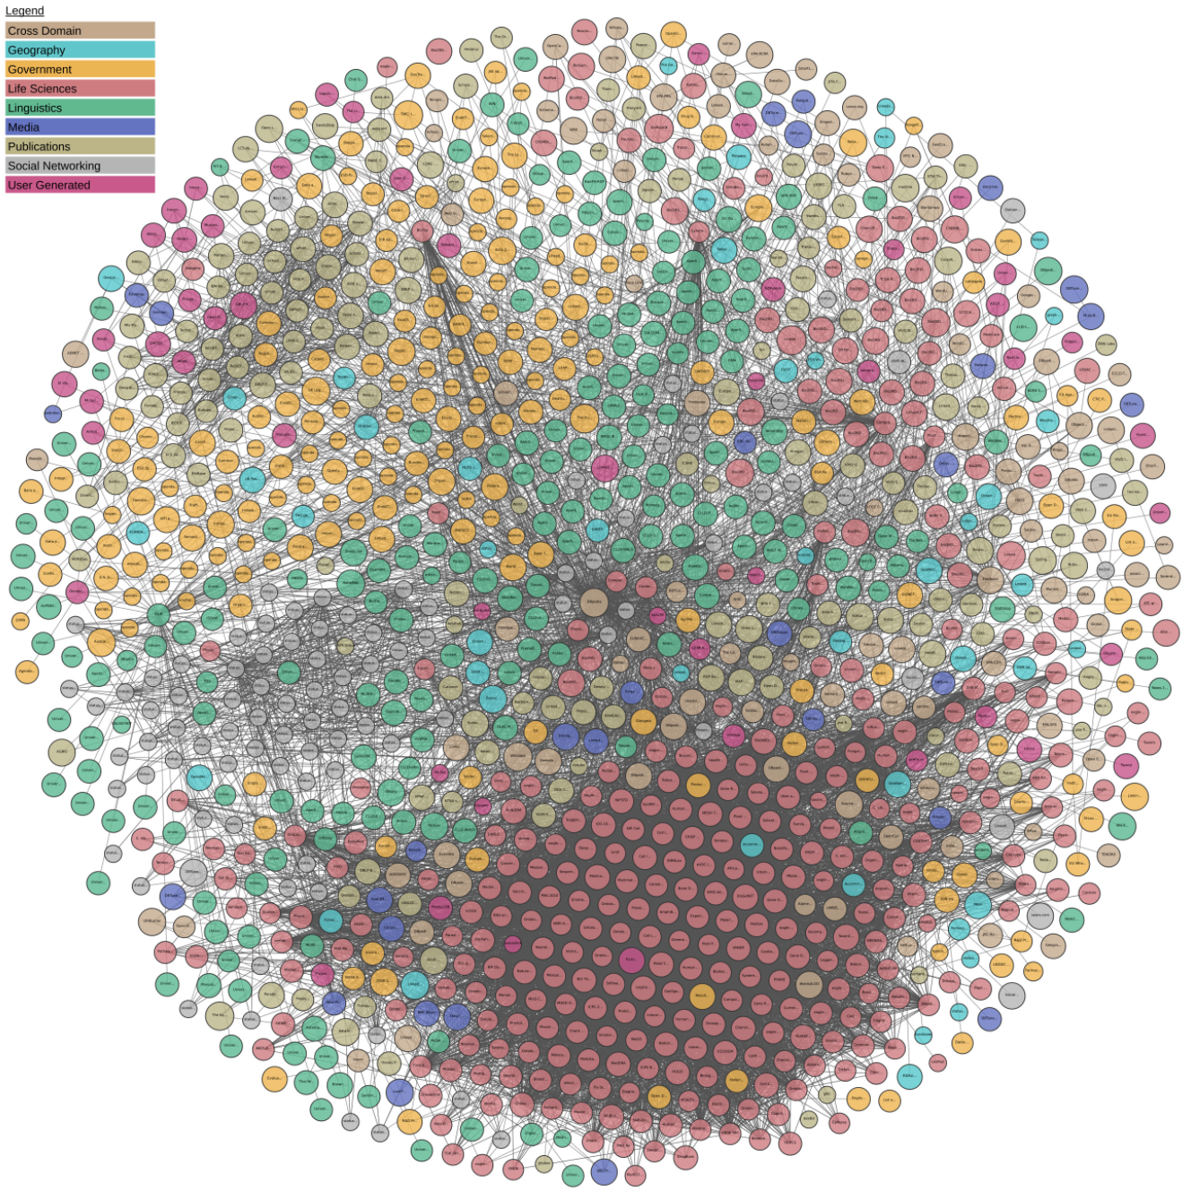
synaptica
Linked Data
25 years of innovation
Linked Data is about using the Web to connect related data that wasn't previously linked, or using the Web to lower the barriers to linking data currently linked using other methods.*
What is Linked (Open) Data?
*Linked Data. Linked Data. 24 September 2019. http://linkeddata.org/home.
40

Slide 41
synaptica
Linked Data
25 years of innovation
The term Linked Data refers to a set of best practices for publishing structured data on the Web. These principles have been coined by Tim Berners-Lee in the design issue note Linked Data. The principles are:
Use URIs as names for things
Use HTTP URIs so that people can look up those names
When someone looks up a URI, provide useful information
Include links to other URIs so that they can discover more things
Use standards for the representation and the access to data on the Web.
Use hyperlinks between data from different sources. These hyperlinks connect all Linked Data into a single global data graph.*
What is Linked (Open) Data?
*Linked Data. Linked Data. 24 September 2019. http://linkeddata.org/home.
41

Slide 42
synaptica
Linked Data
25 years of innovation
Linked (Open) Data resources
http://bartoc.org/
https://lod-cloud.net/
Upper Ontologies
      Basic Formal Ontology (BFO)
      Business Objects Reference Ontology (BORO)
      Common Semantic Model (COSMO)
      DCMI Metadata Terms
      Friend of a Friend (FOAF)
      WordNet
Domain Ontologies
      AGROVOC
      Cell Line Ontology (CLO)
      General Multilingual Environmental Thesaurus (GEMET)
      Medical Subject Headings (MeSH)
      Ontology for Biomedical Investigations (OBI)
      UNESCO Thesaurus
42

Slide 43
synaptica
Tools and Systems
25 years of innovation
Ontology Systems and Components (also a Bit about Knowledge Graphs)
Ontology Tools
Graph Databases
Systems Integration
Knowledge Graphs: Connecting Ontologies to Data/Content
43

Slide 44
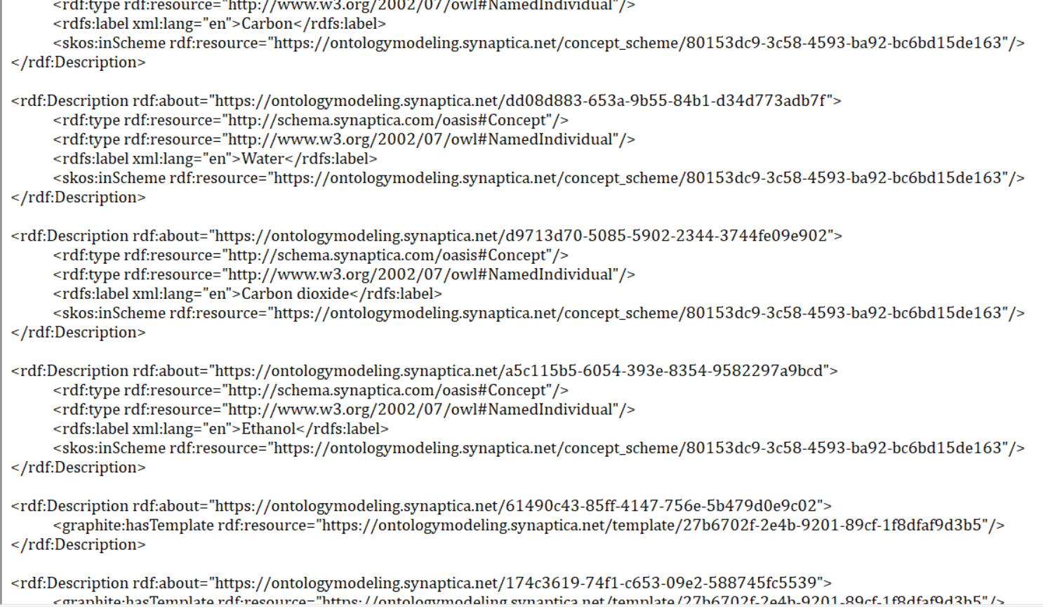
synaptica
The Ontology Management Tool
25 years of innovation
Components
44

Slide 45
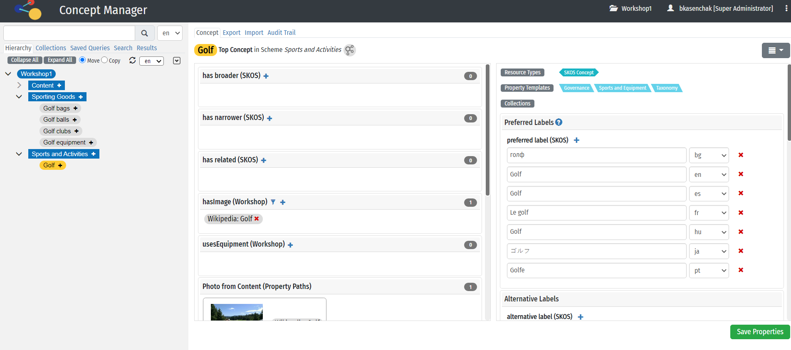
synaptica
The Ontology Management Tool
25 years of innovation
Components
45

Slide 46
synaptica
The Ontology Management Tool
25 years of innovation
Components
User Interface
Build and maintain vocabulary structures
Workflow and governance
Constrain information using business rules
User and permission level management
Visualization tools
API Integrations
46

Slide 47
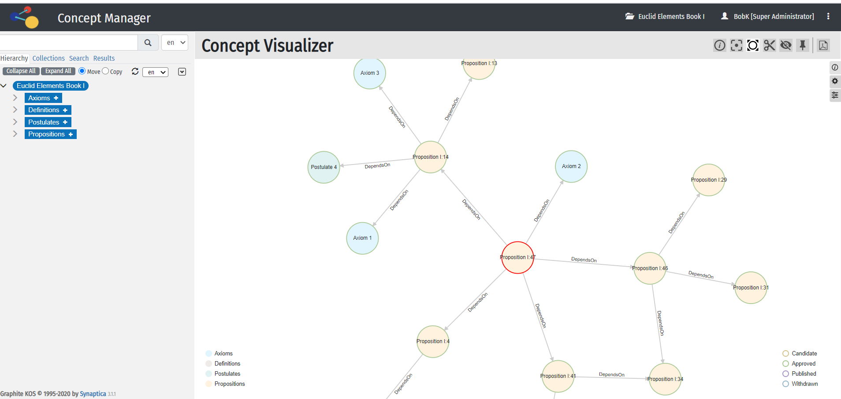
synaptica
The Ontology Management Tool
25 years of innovation
Components
47

Slide 48
synaptica
The Graph Database
25 years of innovation
Components
Underlying and central component
Storing graph information
Also inferencing, Queries/SPARQL
48

Slide 49
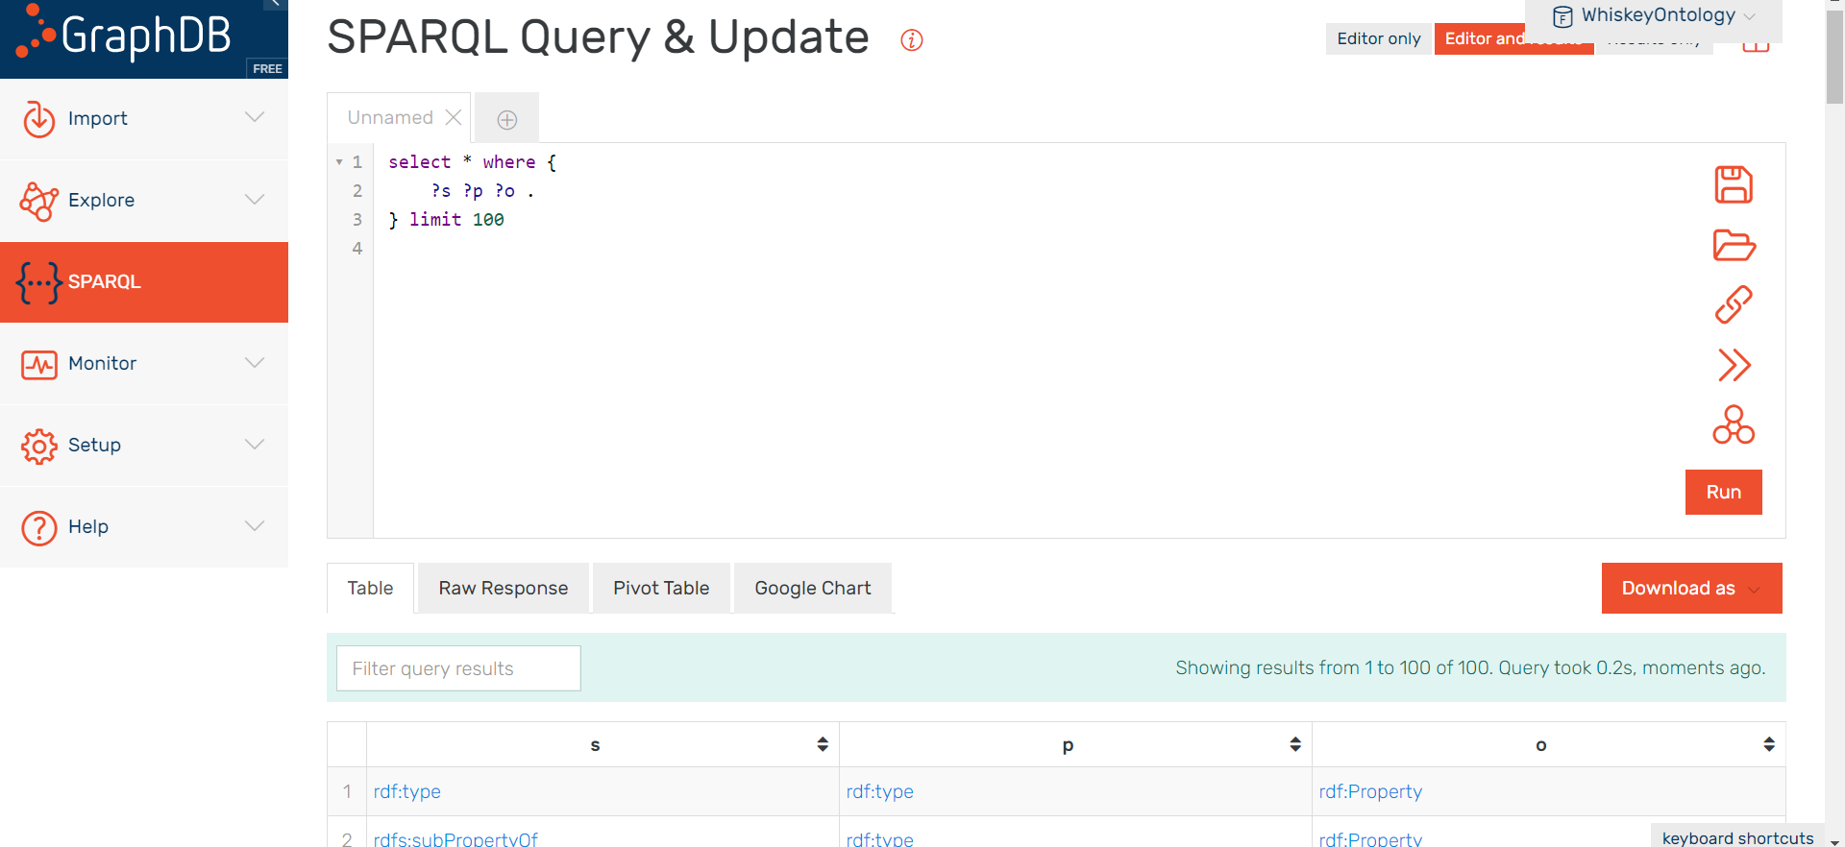
synaptica
The Graph Database
25 years of innovation
Components
49

Slide 50
synaptica
The Stack
25 years of innovation
Sample Stack
Graph Database
Ontology Management Layer
Analytics Endpoints
Content Management Systems
Other Databases
Business Applications
Search Appliances (and Interfaces)
50

Slide 51


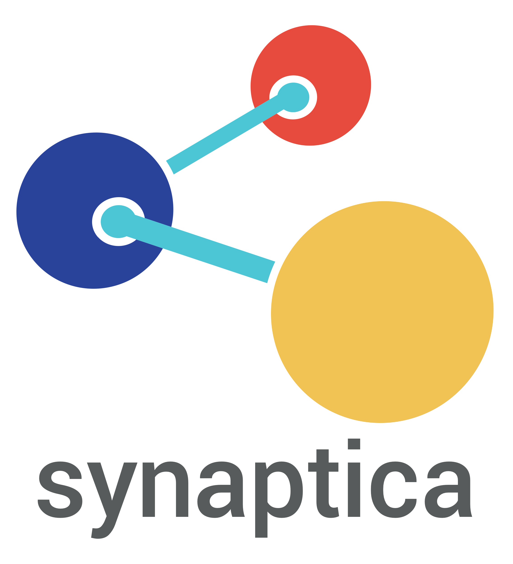









synaptica
The Stack
25 years of innovation
Graphite Knowledge
Organization System
Graphite
REST API Web Services
Enterprise Wiki and
File-based CMS
Read-Write
RDF4J API
Enterprise
Knowledge
Graph
RDF4J API
REST
Enterprise Business
Applications
Read-Write
Read-Write
Read-Write
Controlled Vocabulary I/O Data Flow
Inferencing
and Analytics
Endpoints
Eco-system
of Enterprise applications
Eco-system of consuming applications
Read
REST / RDF4J / SPARQL / GraphQL
Eco-system of consuming applications
RDF Graph
Read-Write
GraphQL
Database
Non-Controlled Vocabulary I/O Data Flow
Write
Write
Search Indexes
Other Databases
51

Slide 52
synaptica
The Knowledge Graph
25 years of innovation
What is a knowledge graph?
By itself, an ontology is the structural underpinning of a knowledge graph
The concepts in an ontology are the interlinked entities described in a formal structure
The ontology structure connects metadata, data, and content; your ontology is a content model and mapping of your domain(s)
When a KOS connects to real-world items, such as web content, and put into action through representation, visualization, querying, and reasoning, it is a knowledge graph
52

Slide 53



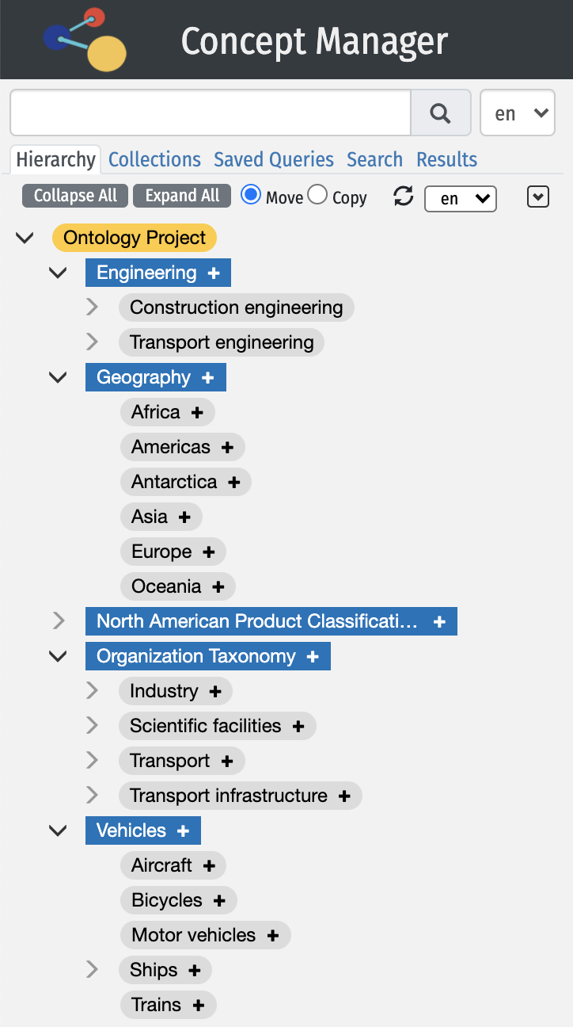


synaptica
Knowledge Graphs
25 years of innovation
Inside Organization
Outside Organization
53

Slide 54
synaptica
Live Ontology Modeling!
25 years of innovation
Knowledge Modeling & Exercise
You should already have received an email with login credentials and a handout about the exercise…
Refer to Handout
Log in
Go to Project
Join Zoom Breakout Room with same # as your Project
Follow instructions
Ping Bob, Ahren, or Jessi if you have questions or need help
We will regroup at [TIME HERE] to discuss the exercise and your models
54

Slide 55
synaptica
Exercise
25 years of innovation
Ontology modeling exercise
The Challenge
You have been hired as a new group of ontologists at a sporting goods company. The organization does not have taxonomy or ontology and needs to model vocabularies to organize website content, products, and topics and connect them to be used for website navigation.
Follow the provided script to start building out your ontology model.
55

Slide 56

synaptica
Exercise Results
25 years of innovation
56

Slide 57
Resources
© 1995 – 2021, Synaptica®

Slide 58
synaptica
Resources
25 years of innovation
Knowledge graphs
George Anadiotis. Linked Data Orchestration Blog/Year of the Graph newsletter. https://linkeddataorchestration.com/the-year-of-the-graph/.
J.Z. Pan et al., eds. Exploiting Linked Data and Knowledge Graphs in Large Organisations. https://www.springer.com/gp/book/9783319456522.
Guilin Qi et al. Knowledge Graph. https://books.google.com/books/about/Knowledge_Graph.html?id=6CsetAEACAAJ&source=kp_book_description.
Ehrlinger, Lisa, and Wolfram Wӧß. “Towards a Definition of Knowledge Graphs.” SEMANTICS 2016: Posters and Demos Track, Leipzig, Germany, September 13-14, 2016. Johannes Kepler University Linz, http://ceur-ws.org/Vol-1695/paper4.pdf.
@Ontotext. “It is not uncommon for ppl to conflate #ontologies w/ #knowledgegraphs especially when even @Wikipedia refers to both terms as synonymous. However, the difference is obvious – a KG is when an ontology is applied to a set of individual data points. https://hubs.ly/H0nbb3F0.” Twitter, 26 February 2020, 6:40 a.m., https://twitter.com/ontotext/status/1232676771914493954.
Deus, Helena. Knowledge Graphs and Machine Learning - ISWC 2018 trip report. 18 October 2018. 30 September 2019. https://www.linkedin.com/pulse/knowledge-graphs-machine-learning-iswc-2018-trip-report-helena-deus/.
58

Slide 59
synaptica
Resources
25 years of innovation
Ontology, Linked Data, Semantic Web
“Ontology (information science).” Wikipedia, Wikimedia Foundation, Inc., 3 August 2019, https://en.wikipedia.org/wiki/Ontology_(information_science).
C. Maria Keet, An Introduction to Ontology Engineering. https://people.cs.uct.ac.za/~mkeet/files/OEbook.pdf.
Knowledge Organization Systems: https://link.springer.com/article/10.1007/s00799-018-0241-2.
Linked Data. Linked Data. 24 September 2019. http://linkeddata.org/home.
Linked Open Data. https://lod-cloud.net/.
Wood, Zaidman & Ruth. Linked Data. https://www.manning.com/books/linked-data.
Allemang & Hendler. Semantic Web for the Working Ontologist. http://www.kevenlw.name/downloads/Ontologist.pdf.
59

Slide 60
synaptica
Resources
25 years of innovation
SKOS, OWL, and RDF
  SKOS
    https://www.w3.org/TR/skos-reference/
    http://www.w3.org/2004/02/skos/core#
  OWL
    https://www.w3.org/TR/2012/REC-owl2-primer-20121211/
    OWL Web Ontology Language Reference. W3C. 11 May 2020. https://www.w3.org/TR/owl-ref/#Class.
  RDF
    “RDF.” W3C Semantic Web, 7 May 2020, https://www.w3.org/RDF/.
    “XML RDF.” W3Schools.com, 7 May 2020, https://www.w3schools.com/xml/xml_rdf.asp.
    “Enter the Realm of Semantic Web Languages.” Medium, 11 May 2020, https://medium.com/swlh/enter-the-realm-of-semantic-web-languages-ee94ee68f544.
  SPARQL
  DuCharme, Bob. Learning SPARQL. O’Reilly. Also http://www.learningsparql.com/
  Schema.org: https://schema.org/
60

Slide 61
synaptica
Resources
25 years of innovation
Graphs and graph databases
  “Graph (abstract data type).” Wikipedia, Wikimedia Foundation, Inc., 3 August 2019, https://en.wikipedia.org/wiki/Graph_%28abstract_data_type%29.
  “Traversing the Land of Graph Computing and Databases.” Humans of Data, 31 July 2019, https://humansofdata.atlan.com/2019/07/what-is-graph-database-and-graph-tech/.
  O’Reilly. Graph Databases. https://graphdatabases.com/.
  “Graph database.” Wikipedia, Wikimedia Foundation, Inc., 23 March 2020, https://en.wikipedia.org/wiki/Graph_database.
  Ontotext: https://www.ontotext.com/knowledgehub/fundamentals/what-is-rdf-triplestore/.
61

Slide 62

Q & A
© 1995 – 2021, Synaptica®

Slide 63
Thank you for joining us!
For more information, please visit
www.synaptica.com
or contact us at
info@synaptica.com
© 1995 – 2021, Synaptica®

